Slide 1

Leon’s Pet Grooming
Reservation System
CS 526 – Advanced Web Programming
Instructor: Dr. Cheung, Ken
Representor: Liang Gu 19633

Slide 2

Agenda
01
Introduction
02
Use Case & Class Diagram
03
UI & Database Design
04
Spring Boot & React
05
Live Demo

Slide 3
Introduction
A website help customers book pet grooming services.
Admin/Customer log in.
Admin edits employee schedule.
Customers edit pet information.
Displays the booking time list.
Customers make an appointment on choosing service kind and time.
The appointment information will be displayed.

Slide 4
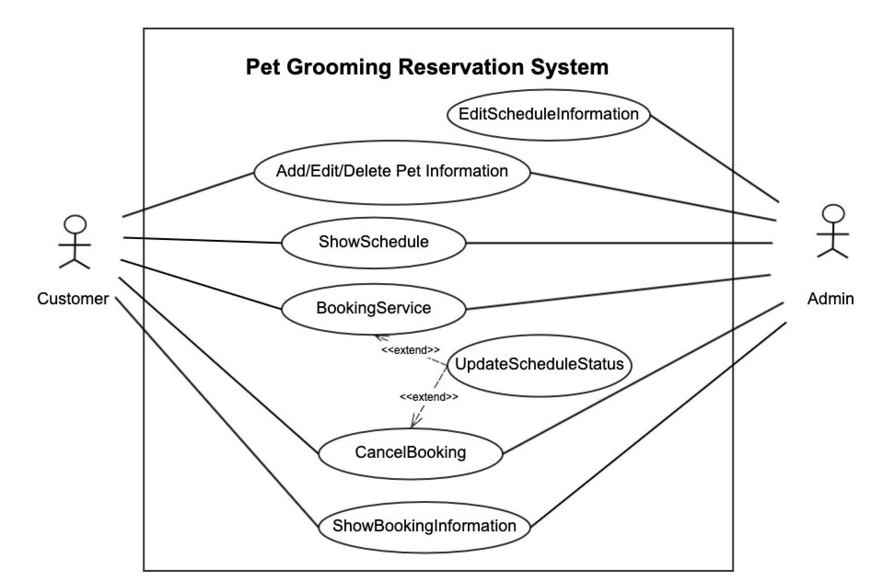
Use Case Diagram

Slide 5
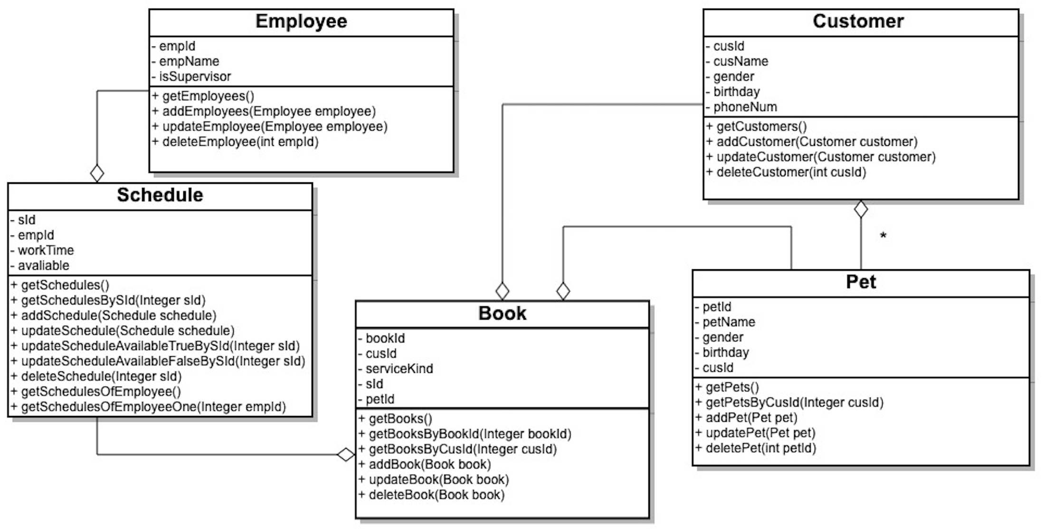
Class Diagram

Slide 6
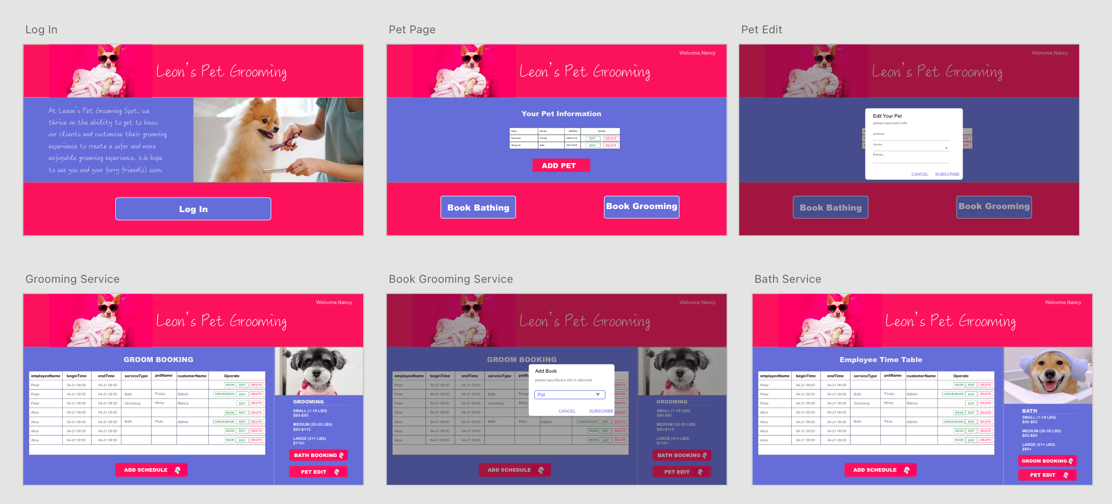
UI Design

Slide 7
Database Design
Table Employee
Table Schedule
 | column name | datatype | description | note
1 | emp_id | int | the id of employee | primary key
2 | emp_name | varchar(20) | the name of employee
3 | is_supervisor | boolean | have priority to edit
 | column name | datatype | description | note
1 | s_id | int | the id of schedule | primary key
2 | emp_id | int | the id of employee
3 | work_time | date | the worktime of employee
4 | available | boolean | Whether can be book | If booked, = False
Table Customer
Table Pet
 | column name | datatype | description | note
1 | cus_id | int | the id of customer | primary key
2 | cus_name | varchar(20) | the name of customer
3 | gender | boolean | the gender of customer | 0 = female, 1 = male
4 | birthday | date | the birthday of customer
5 | phone_num | int | phone number of customer
 | column name | datatype | description | note
1 | pet_id | int | the id of pet | primary key
2 | pet_name | varchar(20) | the name of pet
3 | gender | boolean | the gender of pet | 0 = female, 1 = male
4 | birthday | date | the birthday of pet
5 | cus_id | int | the id of customer
Table Book
 | column name | datatype | description | note
1 | book_id | int | the id of book | primary key
2 | cus_id | int | the id of customer
3 | service_kind | int | the kind of service | 0 = pet wash, 1= pet grooming, ...
4 | s_id | int | the id of schedule
5 | pet_id | int | the id of pet

Slide 8
React
Axios: is a promise-based HTTP Client for node.js and the browser.
Features
Make XMLHttpRequests from the browser
Make http requests from node.js
Supports the Promise API
Intercept request and response
Transform request and response data
Cancel requests
Automatic transforms for JSON data
Client side support for protecting against XSRF
useState,useEffect
Material-UI, Antd

Slide 9
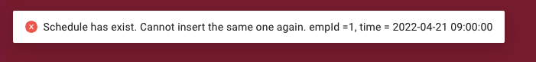

Spring Boot
Implement REST endpoints
Manage Exceptions at the endpoint
Add REST Controller Advice

Slide 10
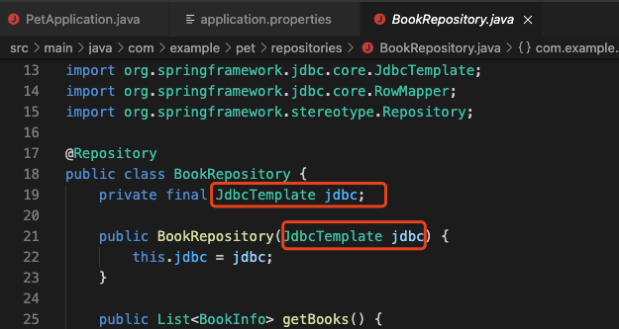
Spring JDBC
JdbcTemplate is the simplest of Spring's tools for working with a relational database. It doesn't need you to utilize any other persistence framework.

Slide 11
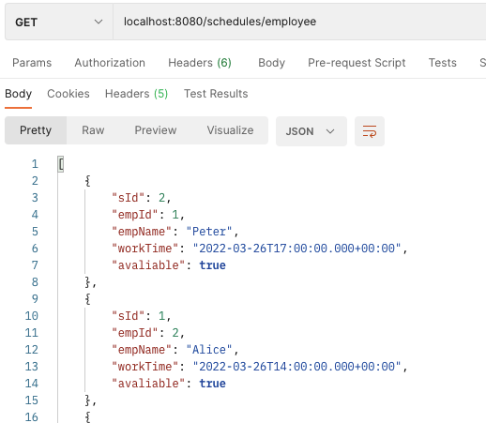
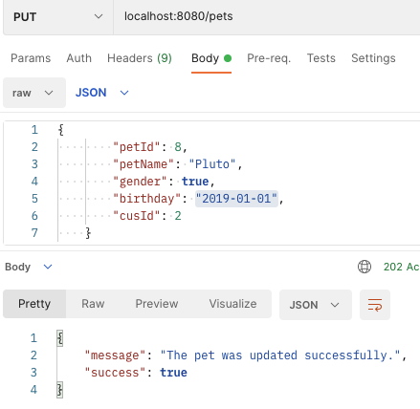
Test Endpoints

Slide 12
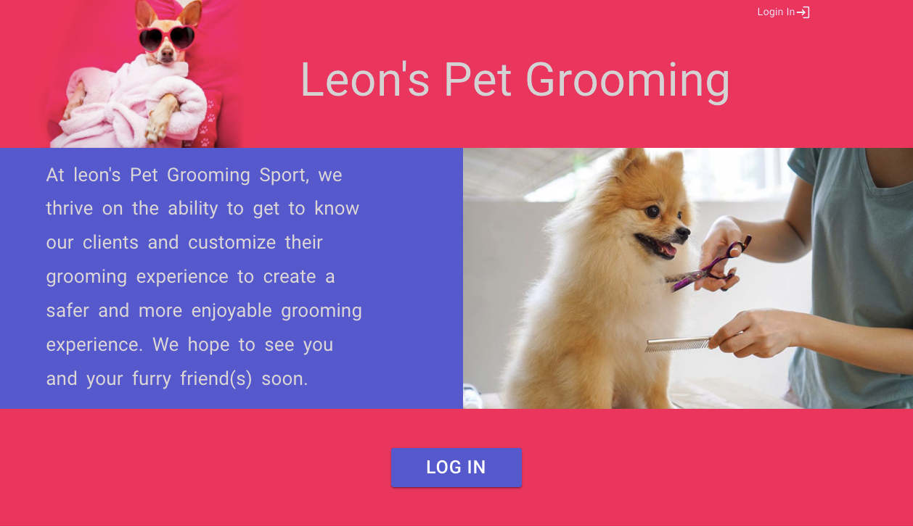
Live Demo
UserName: admin
Password:123456
UserName: Nancy
Password:123456
Deployed:
http://43.156.230.87/

Slide 13

Thank you for
your time!

